Slide 1
Counting Triangles in Data Streams

Slide 2
Why Streaming Graph Processing
We consume events in real-time
• Get results faster
• No need to wait for the job to finish
• Get results continuously
• Process unbounded number of events

Slide 3
Why approximations
Memory limitations
- internet/web graph (2⁶⁴ possible edges)
- online social networks (10¹¹ edges)
Update time
- real-time update
No necessary exact answer
- connectivity / reachability between nodes
- triangle count
- pagerank / topk
· · ·

Slide 4
How estimate
Sample
- no preservation of graph elements
- do sampling with graph stream
Summarization
- preserve graph elements and even structure
- far smaller space than original graph
- update with graph stream

Slide 5
How summarize
Spanners
- connectivity of graph
- distance
Sparsifiers
- all cuts of graph
Sketches
- homomorphic properties
- node/edge/path/subgraph

Slide 6
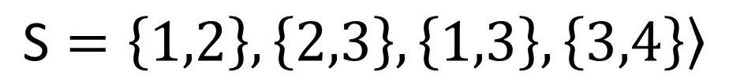
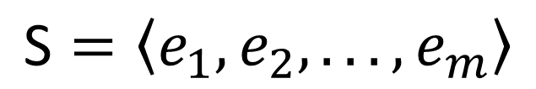
Graph Stream
Stream of edges
$$\text{S}=〈e_{1},e_{2},...,e_{m}〉$$
1
3
4
2
$$\text{S}=\left\{\left.1,2\right\}\right.,\left\{\left.2,3\right\}\right.,\left\{\left.1,3\right\}\right.,\left\{\left.3,4\right\}\right.〉$$

Slide 7
Counting Triangles in Data Streams (sample)
Arbitrary Streams
- 3 Pass Algorithm
- 1 Pass Algorithm
Incidence Streams
- 3 Pass Algorithm
- 1 Pass Algorithm

Slide 8
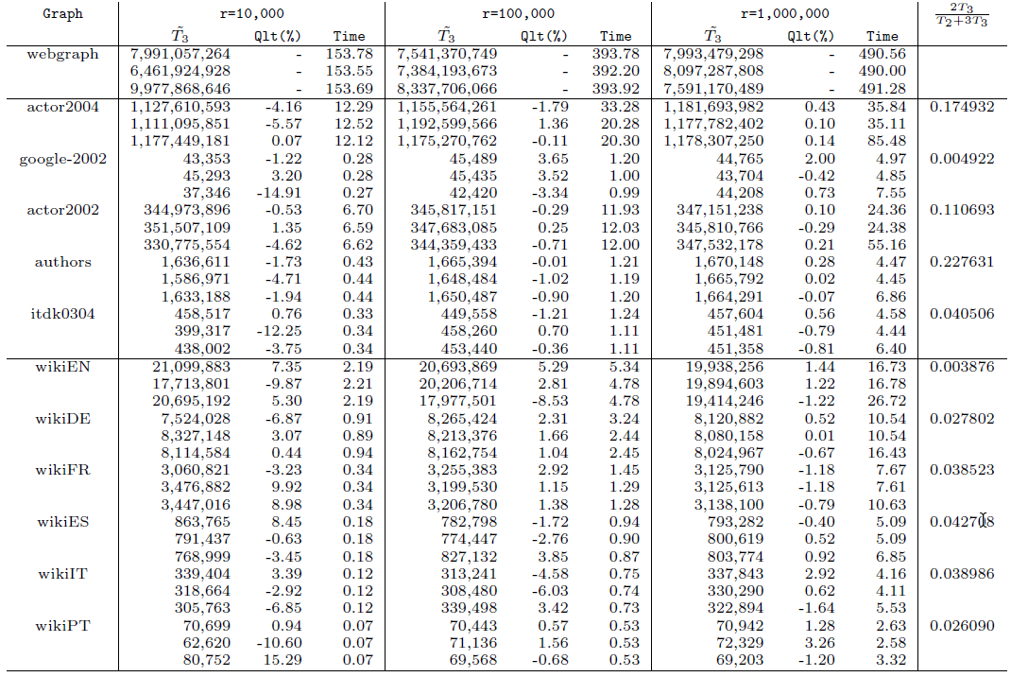

Slide 9
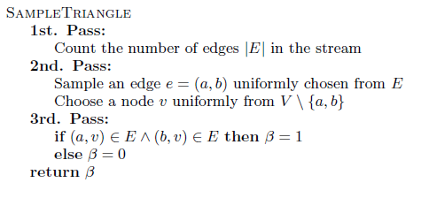


Arbitrary Streams
3 Pass Algorithm
Estimated triangle count
Instance count and approximation quality

Slide 10
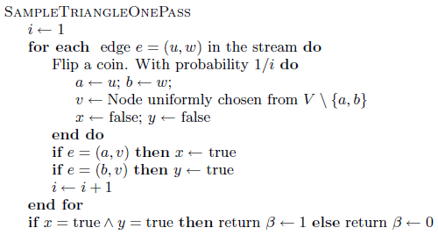

Arbitrary Streams
1 Pass Algorithm
Estimated triangle count
Instance count and approximation quality
reservoir sampling

Slide 11
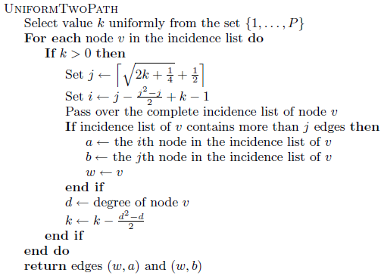
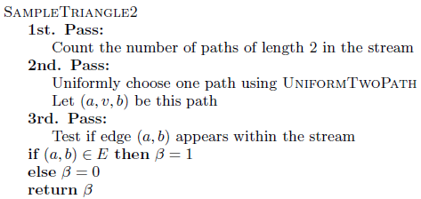


Incidence Streams
3 Pass Algorithm
Estimated triangle count
Instance count and approximation quality

Slide 12


Incidence Streams
1 Pass Algorithm
start 3log|V| instances of the streaming algorithm, an instance for each guess of the number of length-2-paths in the {1, 2, 4, 8, …, |V|³}.
Estimated triangle count
Instance count and approximation quality
$$\overset{\sim }{P}$$

Slide 13
Experiments
Enviroments
· codes were written in C/C++, and compiled with the gcc compiler version 3.2.2.
· experiments were performed on a 2.4 GHz Intel Pentium IV computer with 512 MB of RAM, running Linux, and compiled with g++ version 3.3.2.
· experiments for the webgraph were performed in a 2.8 GHz Intel Pentium IV computer with 1 GB of RAM, running Linux, due to space requirements.
Contents
· 1 pass algorithm for arbitrary streams
· 1 pass algorithm for incidence streams

Slide 14
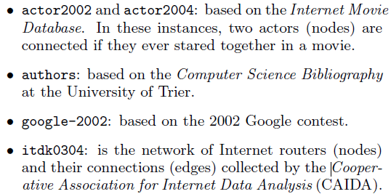
Experiments
Dataset
· one instance webgraph, 135 million nodes, 1 billion edges obtained from a graph extracted in 2001 by the WebBase project at Stanford.
· instances used in the experiments reported in [ Finding,counting and listing all triangles in large graphs, anexperimental study., WEA, 2005, pp. 606–609] .
· instances is originated from the link structure of WikipediaWikipedia. Each article is a node and each hyperlink between nodes identifies a directed arc. The experiments were performed considering the graphs wikiEN, wikiDE, wikiFR, wikiES, wikiIT and wikiPT, extracted from the English, German, French, Spanish, Italian and Portuguese languages, respectively

Slide 15
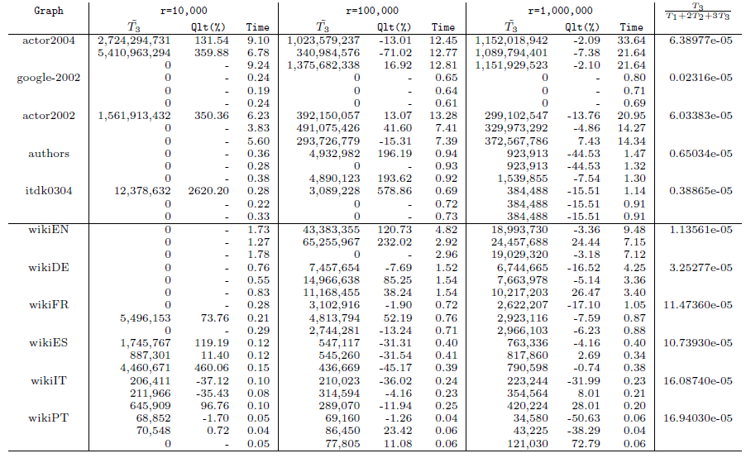
Experiment Result
1 pass algorithm for arbitrary streams

Slide 16
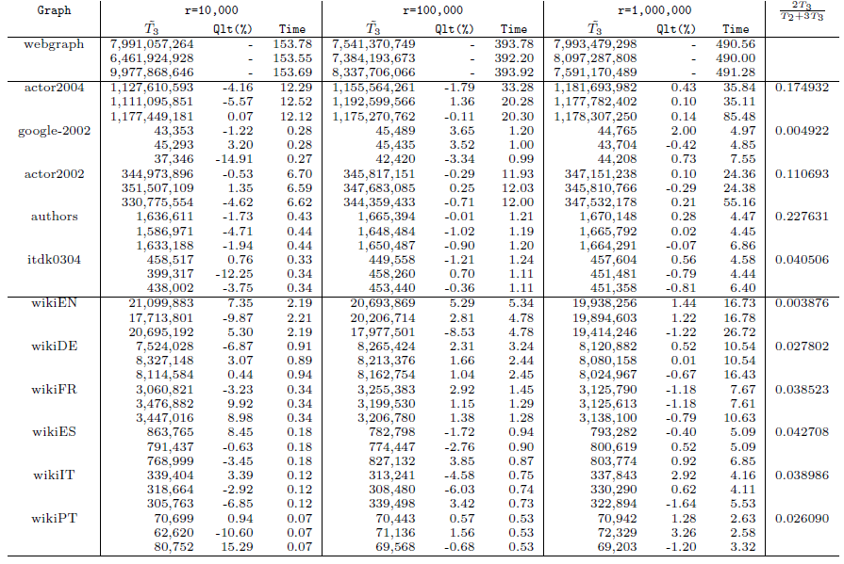
Experiment Result
1 pass algorithm for incidence streams

